Slide 1
Project Scope Management

Slide 2
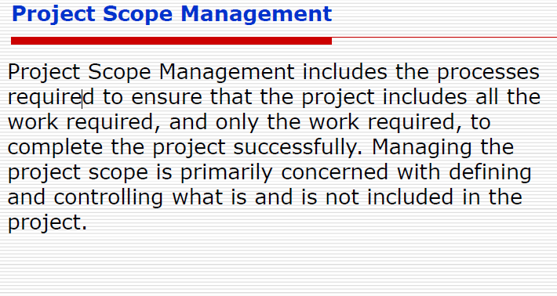
Notes:
Define what does project scope means? --- Scope involves getting information required to start a project, and the features the product that would meet its stakeholders requirements

Slide 3
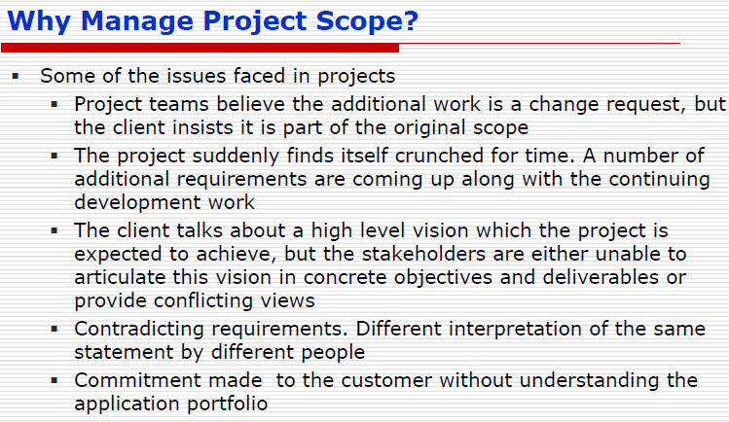
Notes:
Project Team: Changes are additional work. Client : Part of original work
Contradicting Requirements
Commitments made to clients without understanding requirements

Slide 4
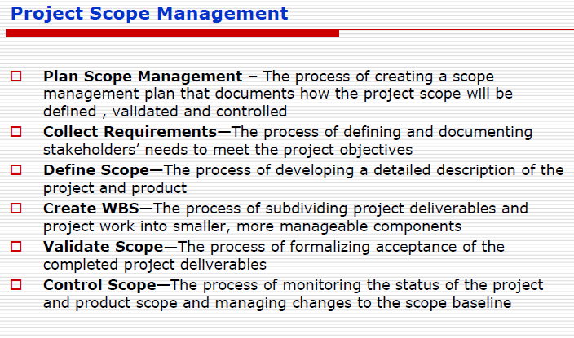

Slide 5
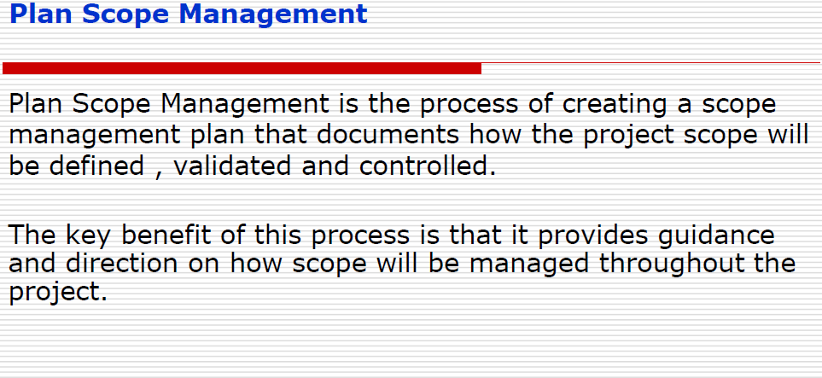
Notes:
Benefit: How scopes will be managed throughout the project
Helps to manage time/schedule, budget, and quality

Slide 6
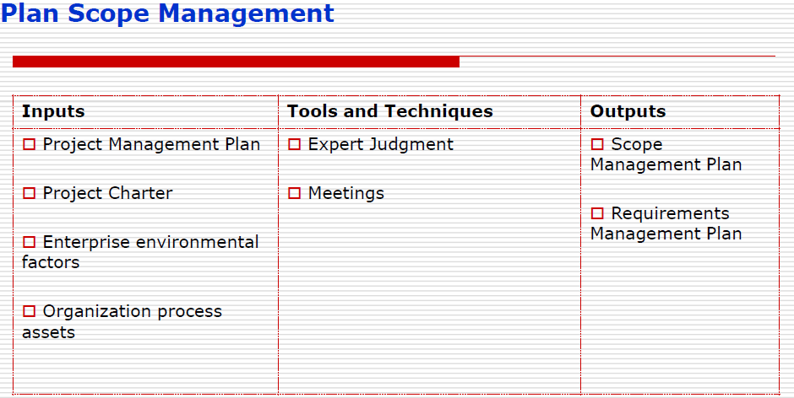

Slide 7
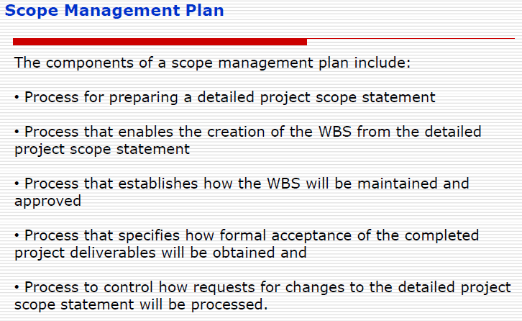

Slide 8
Requirements Management Plan
The requirements management plan is the component of project management plan that describes how requirements will be analyzed, documented, and managed.

Slide 9
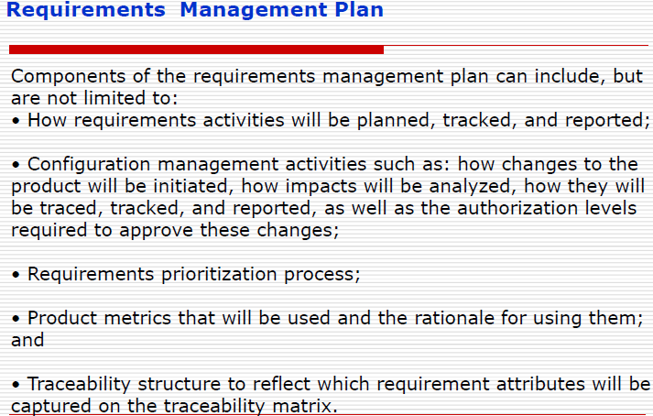
Notes:
Identify requirements’
Prioritize them
Prepare for changes in requirements
How to understand customer requirements clearly

Slide 10
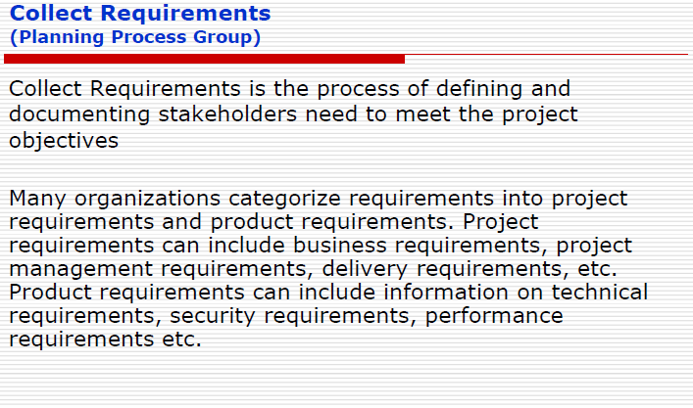

Slide 11
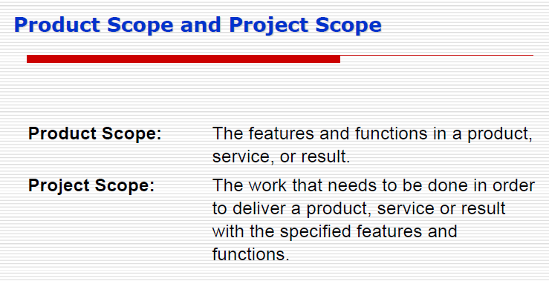
Notes:
Product scope: FEATURES
Project scope: Usability, final result that customer needs

Slide 12
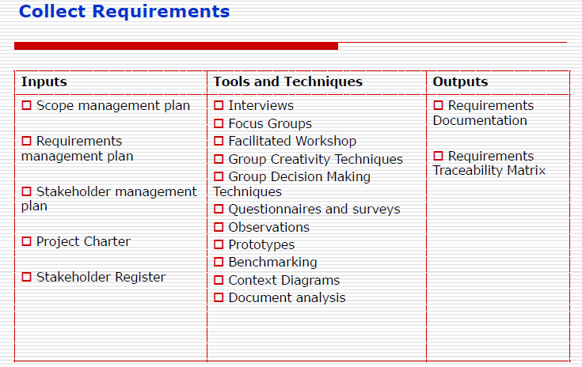

Slide 13
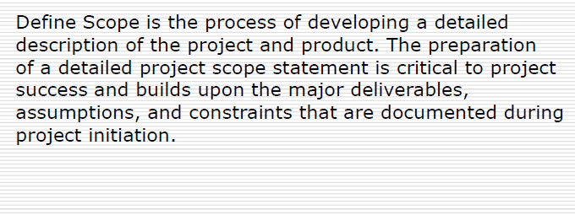
Define Scope

Slide 14
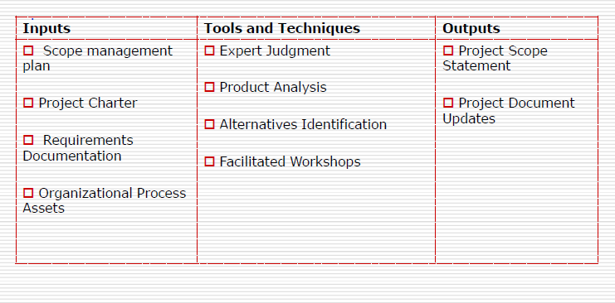
Define Scope

Slide 15
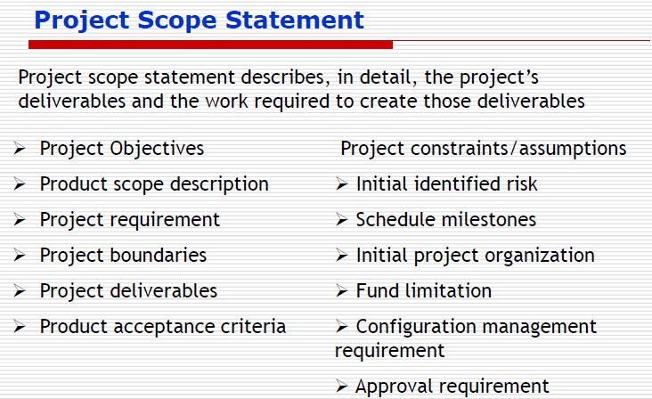

Slide 16
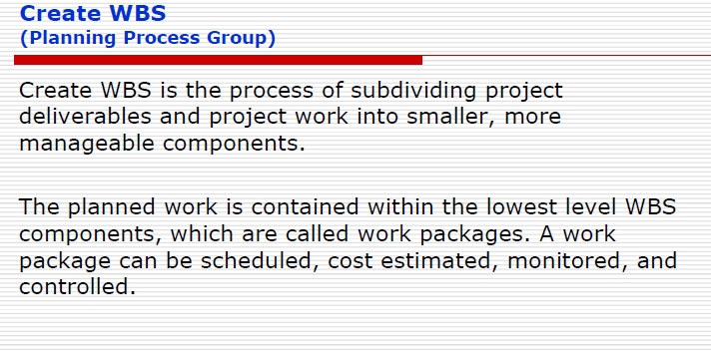
WBS: Work Breakdown Structure

Slide 17
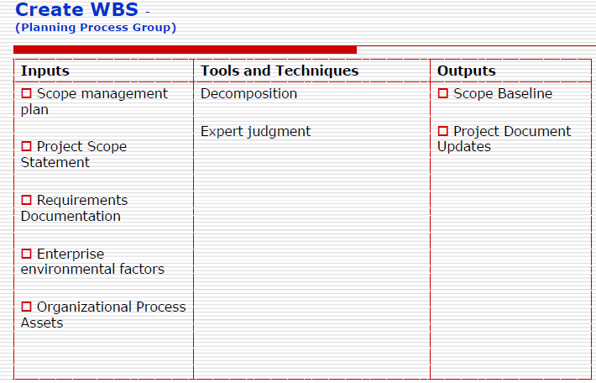

Slide 18
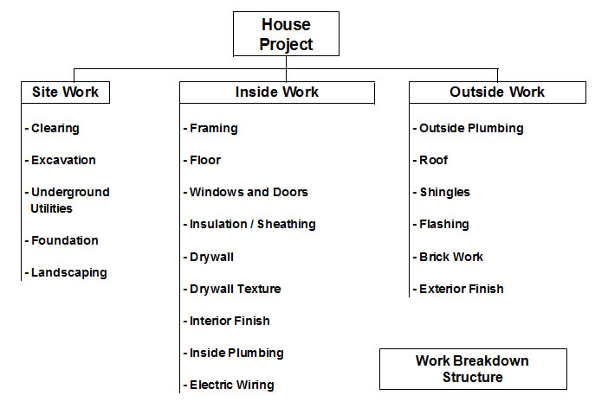
WBS Example

Slide 19
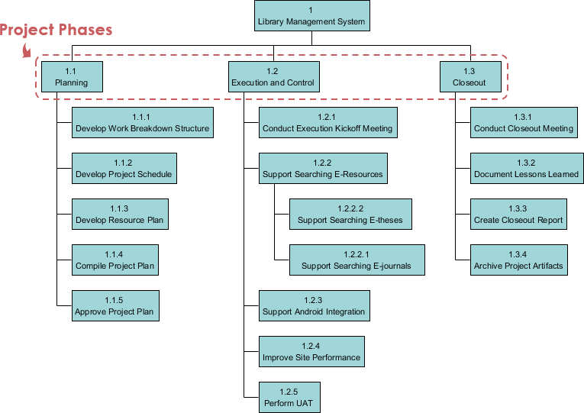
Phase-based WBS

Slide 20
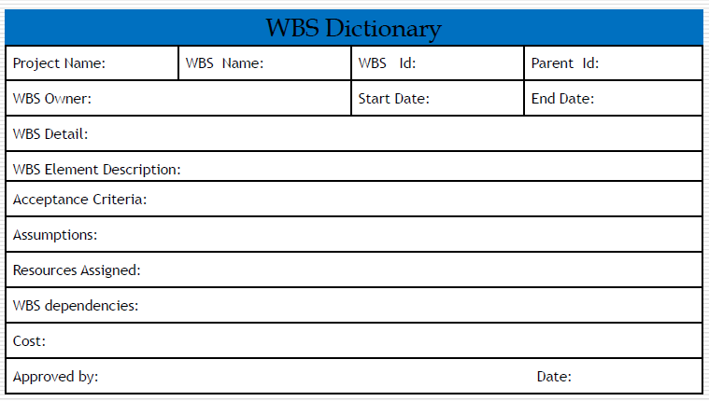
WBS Dictionary Template

Slide 21
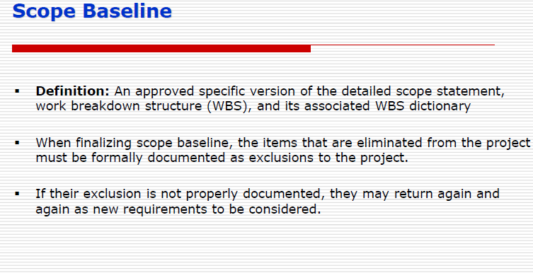

Slide 22
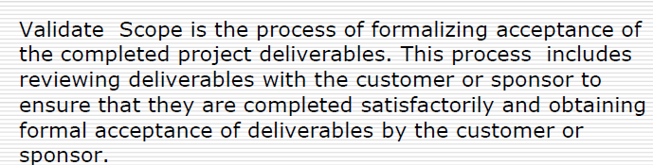
Validate Scope

Slide 23
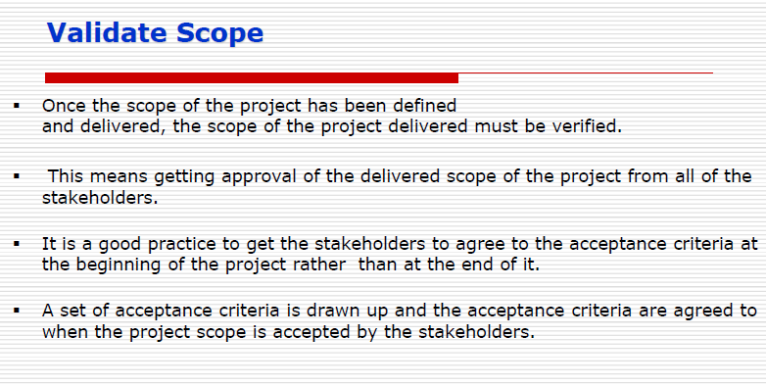

Slide 24
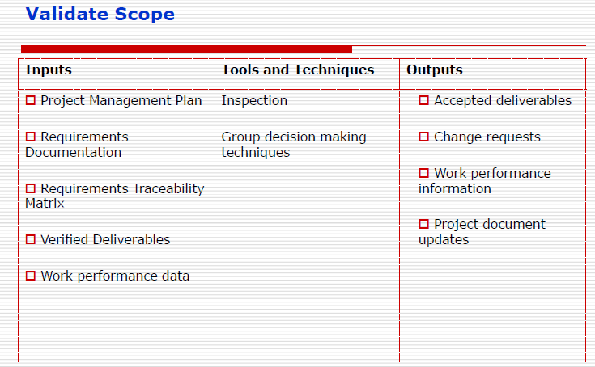

Slide 25
Control Scope
Monitoring the status of thee project and product scope and managing the changes to the scope baseline

Slide 26
